Slide 1
SQL*Plus & Oracle DB

Slide 2
Anforderungsanalyse
Die Datenbank einer Universität beinhaltet Einträge zu Personen, bestehend aus Vor- und Nachnamen. Zu den Personen zählen sowohl Studierende, für die eine Matrikelnummer gespeichert wird, als auch ProfessorInnen mit einem bestimmten Gehalt. Studierende können mehrere Kurse besuchen, die wiederum von einem bestimmten Professor abgehalten werden.

Slide 3
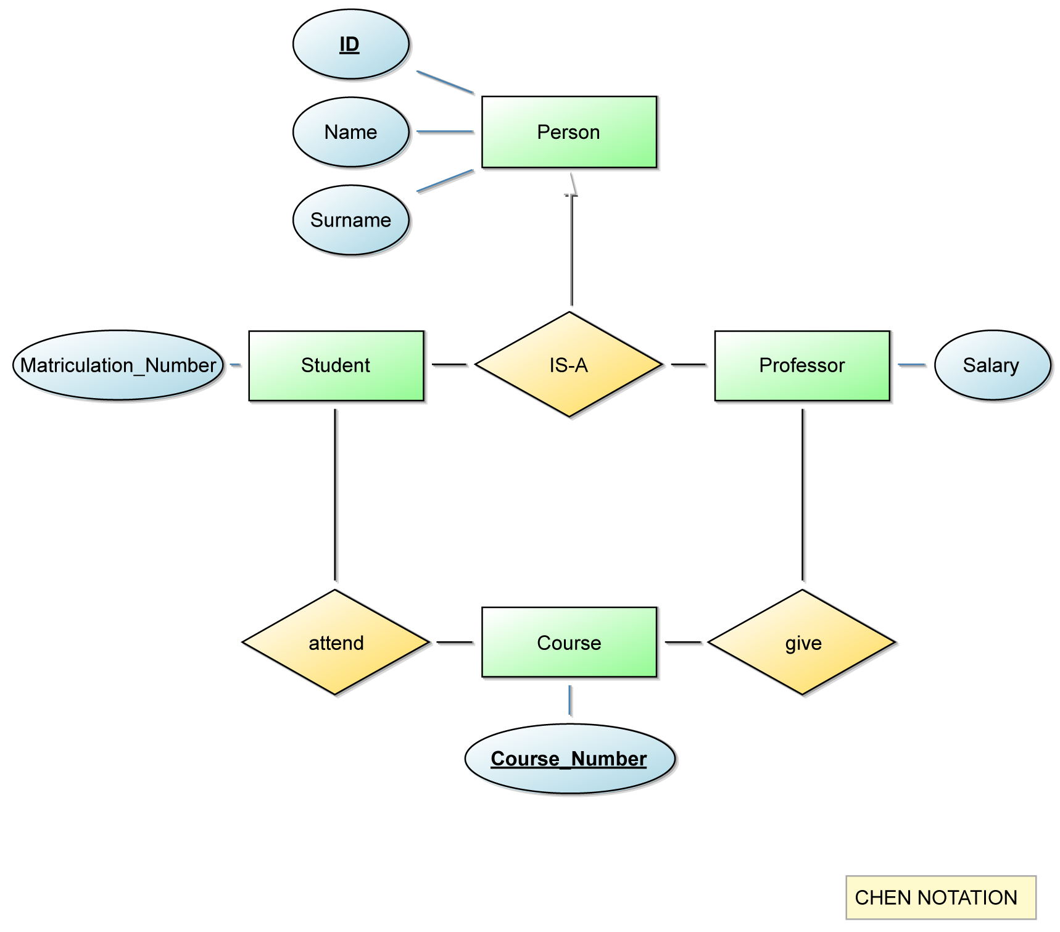
ER Model

Slide 4
Relational Database Schema
Person (ID, Name, Surname)
PK: ID
Student (ID, Matriculation_Number)
PK: ID
FK: Student.ID ◇ Person.ID
Professor (ID, Salary)
PK: ID
FK: Professor.ID ◇ Person.ID
Course (Course_Number, Given_by_id)
PK: Course_Number
FK: Course.Given_by_id ◇ Professor.ID
Attend (Course_Number, ID)
PK: Course_Number, ID
FK: Attend.ID ◇ Student.ID
FK: Attend.Course_Number ◇ Course.Course_Number

Slide 5
SQL 1/2
CREATE TABLE person ( person_id INTEGER NOT NULL, name VARCHAR(20) NOT NULL, surname VARCHAR(20) NOT NULL, CONSTRAINT pk_per_pid PRIMARY KEY (person_id) ); CREATE TABLE student ( student_id INTEGER NOT NULL, matriculation_number INTEGER NOT NULL UNIQUE, CONSTRAINT pk_stu_sid PRIMARY KEY (student_id), CONSTRAINT fk_stu_sid FOREIGN KEY (student_id) REFERENCES person (person_id) ON DELETE CASCADE ); CREATE TABLE professor ( professor_id INTEGER NOT NULL, salary INTEGER NOT NULL CHECK (salary >= 0), CONSTRAINT pk_pro_pid PRIMARY KEY (professor_id), CONSTRAINT fk_pro_pid FOREIGN KEY (professor_id) REFERENCES person (person_id) ON DELETE CASCADE ); CREATE TABLE course ( course_number INTEGER NOT NULL, name VARCHAR(200) NOT NULL, heldby_id INTEGER, CONSTRAINT pk_cou_cnu PRIMARY KEY (course_number), CONSTRAINT fk_cou_nme FOREIGN KEY (heldby_id) REFERENCES professor (professor_id) ON DELETE SET NULL );

Slide 6
SQL 2/2
CREATE TABLE attend ( student_id INTEGER NOT NULL, course_number INTEGER NOT NULL, CONSTRAINT pk_att_sid PRIMARY KEY (student_id, course_number), CONSTRAINT fk_att_sid FOREIGN KEY (student_id) REFERENCES student (student_id) ON DELETE CASCADE, CONSTRAINT fk_cou_cnu FOREIGN KEY (course_number) REFERENCES course (course_number) ON DELETE CASCADE );
-- auto incrementation of person_id CREATE SEQUENCE seq_person_pid START WITH 1 MINVALUE 1 INCREMENT BY 1 CACHE 100; CREATE OR REPLACE TRIGGER tri_person_pid BEFORE INSERT ON person FOR EACH ROW BEGIN SELECT seq_person_pid.nextval INTO :new.person_id FROM dual; END;

Slide 7
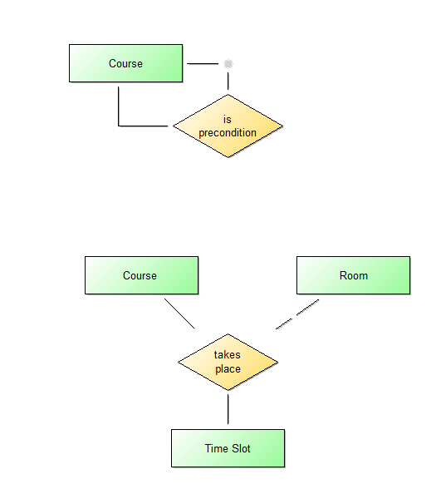
Unary and ternary relations
Precondition (Course_ID, Precondition_ID)
PK: Course_ID, Precondition_ID
FK: Precondition.Course_ID ◇ Course.Course_Number
FK: Precondition.Precondition_ID ◇ Course.Course_Number
Takes_Place (Course_ID, Room_ID, TimeSlot_ID)
PK: Course_ID, Precondition_ID, TimeSlot_ID
FK: Takes_Place.Course_ID ◇ Course.Course_Number
FK: Takes_Place.Room_ID ◇ Room.Room_Number
FK: Takes_Place-TimeSlot_ID ◇ TimeSlot.ID

Slide 8
Preview of JAVA App design
DataGenerator.java
Contains only 1 Method => main() => starting point
DatabaseHelper.java
Encapsulates communication with database
Creates and closes connection
Provides methods for INSERT and SELECT
RandomHelper.java
Provides convenient access to all kinds of random data (+ .csv reader)
TableHelper.java
Simple enum just to minimize hardcoding names

